Slide 1
Linux
Session 2

Slide 2
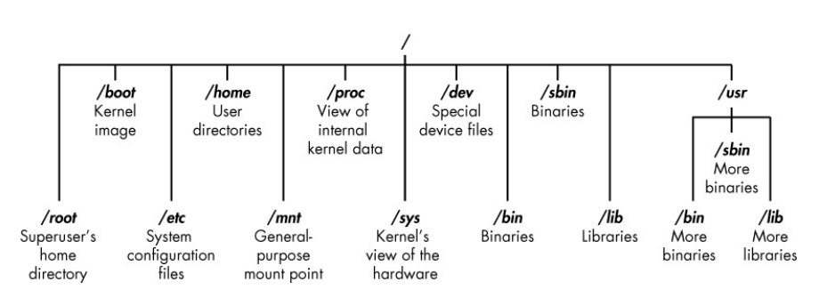
File-system in linux

Slide 3
Commands are files??
Everything in linux is either a file or a process. Let’s see how!

Slide 4
Lets try a few commands!
Commands: whoami, pwd, cd, ls, locate, find, grep, chmod, ps aux, touch, cat, cp, mkdir, mv, rm

Slide 5
HELP
Commands and parameters: -h, --help, man

Slide 6
Stay up-to date
apt update
apt upgrade
apt dist-upgrade

